Slide 2
Display large data sets with Xamarin.Forms CollectionView
David Ortinau
Principal Program Manager
david.ortinau@microsoft.com
twitter.com/davidortinau twitch.tv/davidortinau
Notes:
What are our options for displaying collections of data?
BindableLayout – good for small sets of data. non-virtualized, no emptyview, RefreshView
ListView – good for vertical lists of data, traditional UX, virtualized, viewcells, built in reload ux
CollectionView – modern controls, handles variety of layouts, virtualized, emptyview, no viewcells, itemsthresholdremaining, RefreshView
Use Xappy and the blog?
Use Zimmer?
Beware conference wifi
1/ intro control options
2/ code demo to show CollectionView
3/ Add emptyview
4/ Add refreshview
5/ Add template selector
6/ Add infinite load pagination on scroll

Slide 3


David Ortinau
Principal Program Manager
Mobile Developer Tools
Xamarin
david.ortinau@microsoft.com

Slide 4
CollectionView: Xamarin.Forms 4.3
EmptyView
New Layouts
LinearItemsLayout: Horizontal, Vertical
GridItemsLayout
CustomLayout
Incremental Loading
RemainingItemsThreshold
RemainingItemsThresholdReachedCommand
RemainingItemsThresholdReachedCommandParameter

Slide 5
CollectionView: Xamarin.Forms 4.3
Grouping
Header
Footer
Item Snapping
Item Spacing
ListView Tip: No ViewCells in favor of performance

Slide 6
Selection
Modes
None
Single
Multiple
Selection is for identifying items on which you will do work separately.
You "can" use selection as a way to trigger a navigation or other event.
Otherwise, use gestures.

Slide 7
Show Me Code!
github.com/davidortinau/FlyMe

Slide 8
Pull To Refresh
RefreshView – a container to add around any scrollable content
<RefreshView IsRefreshing="{Binding IsRefreshing}"
Command="{Binding RefreshCommand}">
<ScrollView>
<FlexLayout Direction="Row"
Wrap="Wrap"
AlignItems="Center"
AlignContent="Center"
BindableLayout.ItemsSource="{Binding Items}"
BindableLayout.ItemTemplate="{StaticResource ColorItemTemplate}" />
</ScrollView>
</RefreshView>

Slide 9
Thanks!
David Ortinau
Principal Program Manager
Mobile Developer Tools
Xamarin
david.ortinau@microsoft.com

Slide 10
Presentation title
Speaker name
Title

Slide 11
Text layout (without bullet points)
Main topic: Segoe UI, size 28pt
Segoe UI, size 20pt for second level
Segoe UI, size 16pt for third level

Slide 12
Text layout with bulleted text
Main topic: Segoe UI, size 28pt
Segoe UI, size 20pt for second level
Segoe UI, size 16pt for third level

Slide 13
Example with longer headline text wrapping to a second line
When the headline text is 2 lines, move this text block down to align to the lower blue guide
If you don’t see guidelines, click on the View menu, and then check the box in front of “Guides”
Use a “soft return” Shift + Enter to wrap text without adding extra line spacing

Slide 14
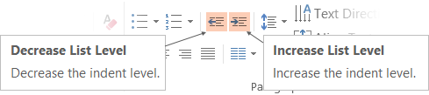
Adjusting list levels
Main topic: Segoe UI, size 28pt
Segoe UI, size 20pt for second level
Segoe UI, size 16pt for third level
Use the “Decrease List Level” and “Increase List Level” tools on the Home menu to change text levels.
Try this:
Place your cursor in the line of text that says “Segoe UI, size 20pt for second level”
Next click the Home tab, and then on the “Decrease List level” tool. Notice how the line moves up one level.
Now try placing your cursor in one of the top “Main topic…” line of text. Click the “Increase List Level” tool and see how the text is pushed in one level.
Use these 2 tools to adjust your text levels as you work

Slide 15
Bullet points layout with subtitle Set the subtitle to 20pt in the same text block, with character spacing Normal
Move the text block down vertically to align to lower guide
If you don’t see guidelines, click on the View menu, and then check the box in front of “Guides”
Hyperlink style: www.microsoft.com

Slide 16
Title square photo layout
Smaller text

Slide 17
Square photo layout

Slide 18
Slide palette info
The PowerPoint palette for this template has been built for you and is shown below.
Avoid using too many colors in your presentation.
PowerPoint Theme Accent colors
Accent 1
Accent 2
Accent 3
Accent 4
Accent 5
Accent 6
Use Accent 1 as the main accent color.
Use Accent 2 and Accent 3 only when additional colors are needed.
Use Accents 4-6 sparingly

Slide 19
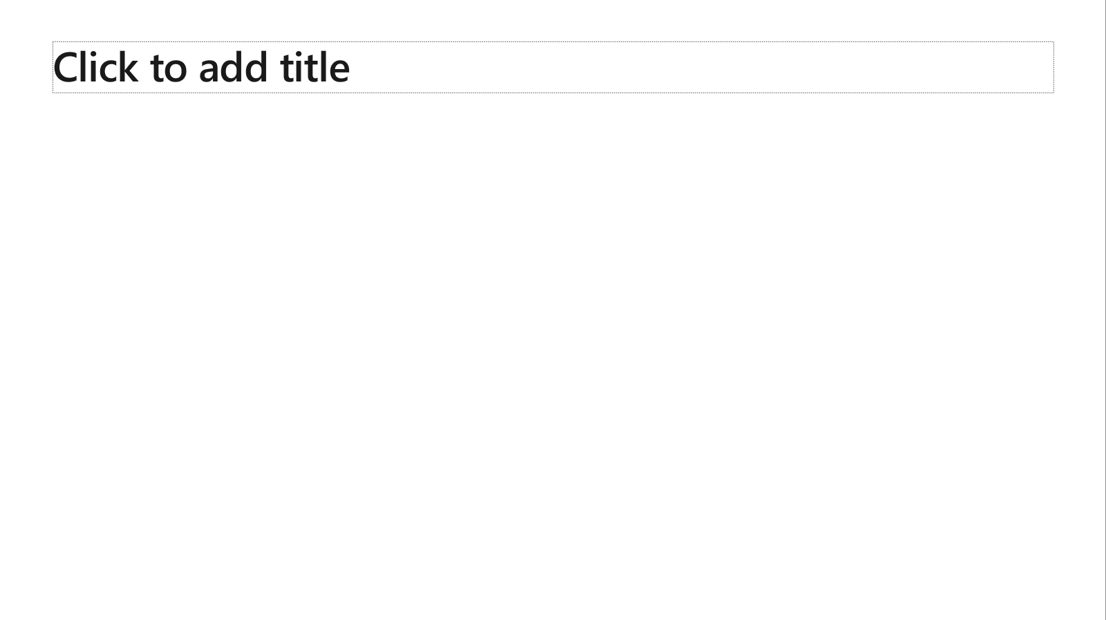
Ensure slide content is accessible
Take the following steps to create accessible content that everyone can consume effectively.
Contrast
Use high contrast colors for maximum readability
The recommended contrast ratio is at least 4.5:1
Shape and color
Use different shapes with a legend to indicate statuses to accommodate for color blindness
Example:
Alt text
Alt text helps people with screen readers understand the content of slides
You should create alternative text for shapes, pictures, charts, tables, SmartArt graphics, or other objects
Here’s how:
Right click on item
Select Edit Alt Text
Enter a Description
If an object is meant to add visual styling and doesn’t contain meaning (e.g. stylistic borders), do not add alt text and instead check Mark as decorative
Slide layouts
Using a built-in slide layout that matches your content ensures a hierarchical reading order of text blocks
Example:
If a new slide will have a title, rather than starting with a blank layout and adding a text block for the title, choose one of the built-in layouts with a title placeholder
Reading order
Screen readers describe content on the screen in the order it was created
To ensure your content is read back in the order you prefer, arrange your objects in the Selection Pane appropriately. Objects on the bottom of the selection pane are read first
Here’s how:
Click the Home tab
In the Drawing group, select the Arrange drop-down menu
Click Selection Pane…
Text
Text
Text
Subject 1
Subject 2
Subject 3
Color Contrast Analyzer
Download this tool to determine the legibility of text and the contrast of visual elements
Download
C1
C2
C3
Additional tips
Be sure to run the Accessibility Checker! Go to File click the Check for Issues drop down menu click Check Accessibility
Videos need to be accessible: If your presentation includes a video, ensure it is captioned and audio described (if appropriate)
Visit the Office Accessibility Center to learn more about accessibility in PowerPoint

Slide 20
Brand and accent colors accessibility
Type and background combinations must meet a minimum 4.5:1 contrast ratio to help ensure people of all abilities can access and understand our communications.
Pick colors carefully and avoid relying on color alone to convey information. Always provide text or other graphical cues to guide customers to our message.
Examples demonstrate correct color use for on-screen applications.
Get the Color Contrast Analyzer
Get more information on accessibility
Get the Microsoft color guidelines PDF
Dark Orange
Rich Black
R255 G147 B73 Hex #FF9349
Dark Yellow
Rich Black
R254 G240 B0 Hex #FEF000
Dark Green
Rich Black
R155 G240 B11 Hex #9BF00B
Dark Teal
Rich Black
R48 G229 B208 Hex #30E5D0
Dark Blue
Rich Black
R80 G230 B255 Hex #50E6FF
Dark Purple
Rich Black
R213 G157 B255 Hex #D59DFF
White
Rich Black
R216 G59 B1
Hex #D83B01
Rich Black
R255 G185 B0
Hex #FFB900
White
R16 G124 B16
Hex #107C10
White
Rich Black
R0 G133 B117
Hex #008575
White
Rich Black
R0 G120 B212
Hex #0078D4
White
Rich Black
R134 G97 B197
Hex #8661C5
Light Orange
White
R107 G41 B41 Hex #6B2929
Light Yellow
White
R106 G75 B22 Hex #6A4B16
Light Green White
R5 G75 B22 Hex #054B16
Light Teal
White
R39 G75 B71 Hex #274B47
Light Blue
White
R36 G58 B94 Hex #243A5E
Light Purple
White
R59 G46 B88 Hex #3B2E58
White
R255 G255 B255
Hex #FFFFFF
Orange
Dark Orange
Dark Yellow
Green
Dark Green
Teal
Dark Teal
Blue
Dark Blue
Purple
Dark Purple
Rich Black
R0 G0 B0
Hex #000000
White
Light Orange
Orange
White
Light Yellow
Yellow
White
Light Green
White
Light Teal
Teal
White
Light Blue
Blue
White
Light Purple
Purple
Extra Light Gray
R242 G242 B242
Hex #F2F2F2
Light Gray
R230 G230 B230
Hex #E6E6E6
Gray
R210 G210 B210
Hex #D2D2D2
Mid Gray
R115 G115 B115
Hex #737373
Dark Gray
R80 G80 B80
Hex #505050
Extra Dark Gray
R47 G47 B47
Hex #2F2F2F

Slide 21





PowerPoint Design Ideas
Get suggestions for slides
PowerPoint Designer can create suggestions for your slide content.
To access Design Ideas, click the “Design” tab in the Ribbon and then “Design Ideas” on the right.
Designer will also trigger when you insert an image.

Slide 22

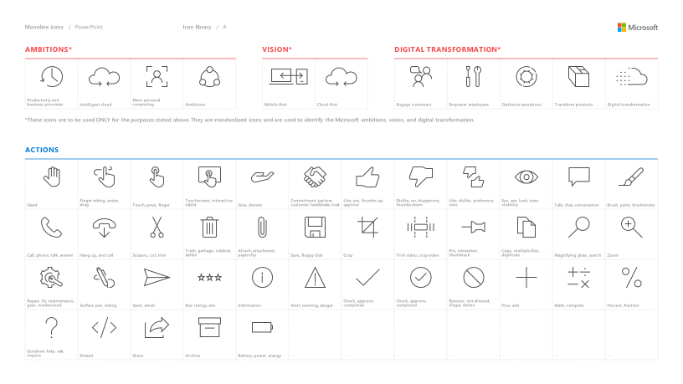
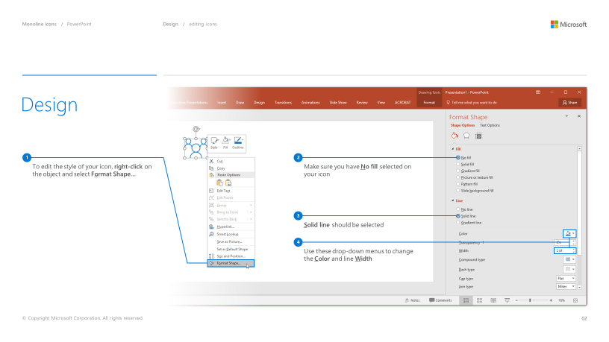
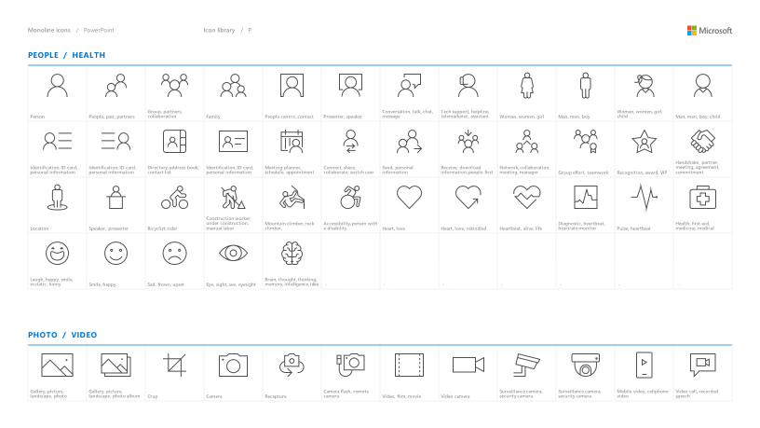
Microsoft monoline icons
Looking for icon resources?
The Monoline icon library for PowerPoint is a slide deck that provides a library of icons for use in PowerPoint presentations.
The Monoline icon style guide for PowerPoint is a pdf with additional guidelines.
Download both from Brand Central.

Slide 23
Demo
Speaker name

Slide 24
Section title

Slide 25
Software code slide
This slide layout uses Consolas, a monotype font which is ideal for showing software code.

Slide 26
Notes (hidden)
Some speakers at Microsoft like to use this slide for hidden “notes slides”.
Delete it if you don’t want to use it.
NEXT: <next slide title>

Slide 29
Presentation title
Speaker name
Title

Slide 30
Presentation title
Speaker name
Title

Slide 31
Presentation title
Speaker name
Title

Slide 32
Presentation title
Speaker name
Title

Slide 33
Text layout (without bullet points)
Main topic: Segoe UI, size 28pt
Segoe UI, size 20pt for second level
Segoe UI, size 16pt for third level

Slide 34
Text layout with bulleted text
Main topic: Segoe UI, size 28pt
Segoe UI, size 20pt for second level
Segoe UI, size 16pt for third level

Slide 35
Example with longer headline text wrapping to a second line
When the headline text is 2 lines, move this text block down to align to the lower blue guide
If you don’t see guidelines, click on the View menu, and then check the box in front of “Guides”
Use a “soft return” Shift + Enter to wrap text without adding extra line spacing

Slide 36
Adjusting list levels
Main topic: Segoe UI, size 28pt
Segoe UI, size 20pt for second level
Segoe UI, size 16pt for third level
Use the “Decrease List Level” and “Increase List Level” tools on the Home menu to change text levels.
Try this:
Place your cursor in the line of text that says “Segoe UI, size 20pt for second level”
Next click the Home tab, and then on the “Decrease List level” tool. Notice how the line moves up one level.
Now try placing your cursor in one of the top “Main topic…” line of text. Click the “Increase List Level” tool and see how the text is pushed in one level.
Use these 2 tools to adjust your text levels as you work

Slide 37
Bullet points layout with subtitle Set the subtitle to 20pt in the same text block, with character spacing Normal
Move the text block down vertically to align to lower guide
If you don’t see guidelines, click on the View menu, and then check the box in front of “Guides”
Hyperlink style: www.microsoft.com

Slide 38
Title square photo layout
Smaller text

Slide 39
Square photo layout

Slide 40
Slide palette info
The PowerPoint palette for this template has been built for you and is shown below.
Avoid using too many colors in your presentation.
PowerPoint Theme Accent colors
Accent 1
Accent 2
Accent 3
Accent 4
Accent 5
Accent 6
Use Accent 1 as the main accent color.
Use Accent 2 and Accent 3 only when additional colors are needed.
Use Accents 4-6 sparingly

Slide 41
Ensure slide content is accessible
Take the following steps to create accessible content that everyone can consume effectively.
Contrast
Use high contrast colors for maximum readability
The recommended contrast ratio is at least 4.5:1
Shape and color
Use different shapes with a legend to indicate statuses to accommodate for color blindness
Example:
Alt text
Alt text helps people with screen readers understand the content of slides
You should create alternative text for shapes, pictures, charts, tables, SmartArt graphics, or other objects
Here’s how:
Right click on item
Select Edit Alt Text
Enter a Description
If an object is meant to add visual styling and doesn’t contain meaning (e.g. stylistic borders), do not add alt text and instead check Mark as decorative
Slide layouts
Using a built-in slide layout that matches your content ensures a hierarchical reading order of text blocks
Example:
If a new slide will have a title, rather than starting with a blank layout and adding a text block for the title, choose one of the built-in layouts with a title placeholder
Reading order
Screen readers describe content on the screen in the order it was created
To ensure your content is read back in the order you prefer, arrange your objects in the Selection Pane appropriately. Objects on the bottom of the selection pane are read first
Here’s how:
Click the Home tab
In the Drawing group, select the Arrange drop-down menu
Click Selection Pane…
Text
Text
Text
Subject 1
Subject 2
Subject 3
Color Contrast Analyzer
Download this tool to determine the legibility of text and the contrast of visual elements
Download
C1
C2
C3
Additional tips
Be sure to run the Accessibility Checker! Go to File click the Check for Issues drop down menu click Check Accessibility
Videos need to be accessible: If your presentation includes a video, ensure it is captioned and audio described (if appropriate)
Visit the Office Accessibility Center to learn more about accessibility in PowerPoint

Slide 42
Brand and accent colors accessibility
Type and background combinations must meet a minimum 4.5:1 contrast ratio to help ensure people of all abilities can access and understand our communications.
Pick colors carefully and avoid relying on color alone to convey information. Always provide text or other graphical cues to guide customers to our message.
Examples demonstrate correct color use for on-screen applications.
Get the Color Contrast Analyzer
Get more information on accessibility
Get the Microsoft color guidelines PDF
Dark Orange
Rich Black
R255 G147 B73 Hex #FF9349
Dark Yellow
Rich Black
R254 G240 B0 Hex #FEF000
Dark Green
Rich Black
R155 G240 B11 Hex #9BF00B
Dark Teal
Rich Black
R48 G229 B208 Hex #30E5D0
Dark Blue
Rich Black
R80 G230 B255 Hex #50E6FF
Dark Purple
Rich Black
R213 G157 B255 Hex #D59DFF
White
Rich Black
R216 G59 B1
Hex #D83B01
Rich Black
R255 G185 B0
Hex #FFB900
White
R16 G124 B16
Hex #107C10
White
Rich Black
R0 G133 B117
Hex #008575
White
Rich Black
R0 G120 B212
Hex #0078D4
White
Rich Black
R134 G97 B197
Hex #8661C5
Light Orange
White
R107 G41 B41 Hex #6B2929
Light Yellow
White
R106 G75 B22 Hex #6A4B16
Light Green White
R5 G75 B22 Hex #054B16
Light Teal
White
R39 G75 B71 Hex #274B47
Light Blue
White
R36 G58 B94 Hex #243A5E
Light Purple
White
R59 G46 B88 Hex #3B2E58
White
R255 G255 B255
Hex #FFFFFF
Orange
Dark Orange
Dark Yellow
Green
Dark Green
Teal
Dark Teal
Blue
Dark Blue
Purple
Dark Purple
Rich Black
R0 G0 B0
Hex #000000
White
Light Orange
Orange
White
Light Yellow
Yellow
White
Light Green
White
Light Teal
Teal
White
Light Blue
Blue
White
Light Purple
Purple
Extra Light Gray
R242 G242 B242
Hex #F2F2F2
Light Gray
R230 G230 B230
Hex #E6E6E6
Gray
R210 G210 B210
Hex #D2D2D2
Mid Gray
R115 G115 B115
Hex #737373
Dark Gray
R80 G80 B80
Hex #505050
Extra Dark Gray
R47 G47 B47
Hex #2F2F2F

Slide 43
PowerPoint Design Ideas
Get suggestions for slides
PowerPoint Designer can create suggestions for your slide content.
To access Design Ideas, click the “Design” tab in the Ribbon and then “Design Ideas” on the right.
Designer will also trigger when you insert an image.

Slide 44
Microsoft monoline icons
Looking for icon resources?
The Monoline icon library for PowerPoint is a slide deck that provides a library of icons for use in PowerPoint presentations.
The Monoline icon style guide for PowerPoint is a pdf with additional guidelines.
Download both from Brand Central.

Slide 45
Demo
Speaker name

Slide 46
Section title

Slide 47
Software code slide
This slide layout uses Consolas, a monotype font which is ideal for showing software code.

Slide 48
Notes (hidden)
Some speakers at Microsoft like to use this slide for hidden “notes slides”.
Delete it if you don’t want to use it.
NEXT: <next slide title>

Slide 51
Presentation title
Speaker name
Title

Slide 52
Presentation title
Speaker name
Title

Slide 53
Presentation title
Speaker name
Title

Slide 54
Presentation title
Speaker name
Title

Slide 55
Text layout (without bullet points)
Main topic: Segoe UI, size 28pt
Segoe UI, size 20pt for second level
Segoe UI, size 16pt for third level

Slide 56
Text layout with bulleted text
Main topic: Segoe UI, size 28pt
Segoe UI, size 20pt for second level
Segoe UI, size 16pt for third level

Slide 57
Example with longer headline text wrapping to a second line
When the headline text is 2 lines, move this text block down to align to the lower blue guide
If you don’t see guidelines, click on the View menu, and then check the box in front of “Guides”
Use a “soft return” Shift + Enter to wrap text without adding extra line spacing

Slide 58
Adjusting list levels
Main topic: Segoe UI, size 28pt
Segoe UI, size 20pt for second level
Segoe UI, size 16pt for third level
Use the “Decrease List Level” and “Increase List Level” tools on the Home menu to change text levels.
Try this:
Place your cursor in the line of text that says “Segoe UI, size 20pt for second level”
Next click the Home tab, and then on the “Decrease List level” tool. Notice how the line moves up one level.
Now try placing your cursor in one of the top “Main topic…” line of text. Click the “Increase List Level” tool and see how the text is pushed in one level.
Use these 2 tools to adjust your text levels as you work

Slide 59
Bullet points layout with subtitle Set the subtitle to 20pt in the same text block, with character spacing Normal
Move the text block down vertically to align to lower guide
If you don’t see guidelines, click on the View menu, and then check the box in front of “Guides”
Hyperlink style: www.microsoft.com

Slide 60
Title square photo layout
Smaller text

Slide 61
Square photo layout

Slide 62
Slide palette info
The PowerPoint palette for this template has been built for you and is shown below.
Avoid using too many colors in your presentation.
PowerPoint Theme Accent colors
Accent 1
Accent 2
Accent 3
Accent 4
Accent 5
Accent 6
Use Accent 1 as the main accent color.
Use Accent 2 and Accent 3 only when additional colors are needed.
Use Accents 4-6 sparingly

Slide 63
Ensure slide content is accessible
Take the following steps to create accessible content that everyone can consume effectively.
Contrast
Use high contrast colors for maximum readability
The recommended contrast ratio is at least 4.5:1
Shape and color
Use different shapes with a legend to indicate statuses to accommodate for color blindness
Example:
Alt text
Alt text helps people with screen readers understand the content of slides
You should create alternative text for shapes, pictures, charts, tables, SmartArt graphics, or other objects
Here’s how:
Right click on item
Select Edit Alt Text
Enter a Description
If an object is meant to add visual styling and doesn’t contain meaning (e.g. stylistic borders), do not add alt text and instead check Mark as decorative
Slide layouts
Using a built-in slide layout that matches your content ensures a hierarchical reading order of text blocks
Example:
If a new slide will have a title, rather than starting with a blank layout and adding a text block for the title, choose one of the built-in layouts with a title placeholder
Reading order
Screen readers describe content on the screen in the order it was created
To ensure your content is read back in the order you prefer, arrange your objects in the Selection Pane appropriately. Objects on the bottom of the selection pane are read first
Here’s how:
Click the Home tab
In the Drawing group, select the Arrange drop-down menu
Click Selection Pane…
Text
Text
Text
Subject 1
Subject 2
Subject 3
Color Contrast Analyzer
Download this tool to determine the legibility of text and the contrast of visual elements
Download
C1
C2
C3
Additional tips
Be sure to run the Accessibility Checker! Go to File click the Check for Issues drop down menu click Check Accessibility
Videos need to be accessible: If your presentation includes a video, ensure it is captioned and audio described (if appropriate)
Visit the Office Accessibility Center to learn more about accessibility in PowerPoint

Slide 64
Brand and accent colors accessibility
Type and background combinations must meet a minimum 4.5:1 contrast ratio to help ensure people of all abilities can access and understand our communications.
Pick colors carefully and avoid relying on color alone to convey information. Always provide text or other graphical cues to guide customers to our message.
Examples demonstrate correct color use for on-screen applications.
Get the Color Contrast Analyzer
Get more information on accessibility
Get the Microsoft color guidelines PDF
Dark Orange
Rich Black
R255 G147 B73 Hex #FF9349
Dark Yellow
Rich Black
R254 G240 B0 Hex #FEF000
Dark Green
Rich Black
R155 G240 B11 Hex #9BF00B
Dark Teal
Rich Black
R48 G229 B208 Hex #30E5D0
Dark Blue
Rich Black
R80 G230 B255 Hex #50E6FF
Dark Purple
Rich Black
R213 G157 B255 Hex #D59DFF
White
Rich Black
R216 G59 B1
Hex #D83B01
Rich Black
R255 G185 B0
Hex #FFB900
White
R16 G124 B16
Hex #107C10
White
Rich Black
R0 G133 B117
Hex #008575
White
Rich Black
R0 G120 B212
Hex #0078D4
White
Rich Black
R134 G97 B197
Hex #8661C5
Light Orange
White
R107 G41 B41 Hex #6B2929
Light Yellow
White
R106 G75 B22 Hex #6A4B16
Light Green White
R5 G75 B22 Hex #054B16
Light Teal
White
R39 G75 B71 Hex #274B47
Light Blue
White
R36 G58 B94 Hex #243A5E
Light Purple
White
R59 G46 B88 Hex #3B2E58
White
R255 G255 B255
Hex #FFFFFF
Orange
Dark Orange
Dark Yellow
Green
Dark Green
Teal
Dark Teal
Blue
Dark Blue
Purple
Dark Purple
Rich Black
R0 G0 B0
Hex #000000
White
Light Orange
Orange
White
Light Yellow
Yellow
White
Light Green
White
Light Teal
Teal
White
Light Blue
Blue
White
Light Purple
Purple
Extra Light Gray
R242 G242 B242
Hex #F2F2F2
Light Gray
R230 G230 B230
Hex #E6E6E6
Gray
R210 G210 B210
Hex #D2D2D2
Mid Gray
R115 G115 B115
Hex #737373
Dark Gray
R80 G80 B80
Hex #505050
Extra Dark Gray
R47 G47 B47
Hex #2F2F2F

Slide 65
PowerPoint Design Ideas
Get suggestions for slides
PowerPoint Designer can create suggestions for your slide content.
To access Design Ideas, click the “Design” tab in the Ribbon and then “Design Ideas” on the right.
Designer will also trigger when you insert an image.

Slide 66
Microsoft monoline icons
Looking for icon resources?
The Monoline icon library for PowerPoint is a slide deck that provides a library of icons for use in PowerPoint presentations.
The Monoline icon style guide for PowerPoint is a pdf with additional guidelines.
Download both from Brand Central.

Slide 67
Section title

Slide 68
Software code slide
This slide layout uses Consolas, a monotype font which is ideal for showing software code.

Slide 69
Notes (hidden)
Some speakers at Microsoft like to use this slide for hidden “notes slides”.
Delete it if you don’t want to use it.
NEXT: <next slide title>

Slide 70
Demo
Speaker name

